Slide 1
CSCI2100E Graph (Part 2)

Slide 2
Single Source Shortest Paths
Given a weighted graph: nodes are cities, edges are roads and weights are the distances between two cities. The weights are equal to or greater than 0.
Find the shortest paths from the source node to any other nodes in the graph.

Slide 3
Dijsktra’s Algorithm
c(x,y): cost (weight) of edge <x, y>; ∞ otherwise
d(v): current distance from the source u to v
S: set of nodes whose least cost path definitively known
1 Initialization:
2 S = {u} /* u is the source */
3 for all nodes v
4 if v adjacent to u
5 then d(v) = c(u,v)
6 else d(v) = ∞
7
8 Loop
9 find w not in S such that d(w) is a minimum
10 add w to S
11 update d(v) for all v adjacent to w and not in S:
12 d(v) = min(d(v), d(w) + c(w,v))
13 /* new cost to v is either old cost to v or known
14 shortest path cost to w plus cost from w to v */
15 until all nodes in S
Time complexity: O(m+n²), but can be improved to O((m+n)logn) with better implementation

Slide 4
Single Source Shortest Paths
A
6
4
B
C
6
4
6
3
2
3
6
D
E
F
7
10
1
6
7
10
9
7
10
8
10
10
Thick red circles are in S, a red circle represents w candidates, and a blue circle represents v.

Slide 5
Dijkstra’s Algorithm
Given a weighted graph, G = (V, E), and assume the weights are equal to or greater than 0.
Find the shortest paths from the source node to any other nodes in the graph.
What is the main idea?
Suppose that we select w with min distance, what is the shortest path to w?
S
w
u
w’

Slide 6
Dijkstra’s Algorithm
The Dijkstra’s algorithm we showed tells us the shortest distance from the source node to any other nodes, but does not tell us the shortest path from the source node to any other notes.

Slide 7
Dijsktra’s Algorithm
c(x,y): cost (weight) of edge <x, y>; ∞ otherwise
d(v): current distance from the source u to v
p(v): predecessor node along the path from the source to v
S: set of nodes whose least cost path definitively known
1 Initialization:
2 S = {u} /* u is the source */
3 for all nodes v
4 if v adjacent to u
5 then d(v) = c(u,v); p(v) = u;
6 else d(v) = ∞
7
8 Loop
9 find w not in S such that d(w) is a minimum
10 add w to S
11 update d(v) for all v adjacent to w and not in S:
12 d(v) = min(d(v), d(w) + c(w,v)), update p(v) if needed
13 /* new cost to v is either old cost to v or known
14 shortest path cost to w plus cost from w to v */
15 until all nodes in S

Slide 8
Dijkstra’s Algorithm: Example
Step
0
1
2
3
4
5
S
u
ux
uxy
uxyv
uxyvw
uxyvwz
d(v),p(v)
2,u
2,u
2,u
d(w),p(w)
5,u
4,x
3,y
3,y
d(x),p(x)
1,u
d(y),p(y)
∞
2,x
d(z),p(z)
∞
∞
4,y
4,y
4,y
5
3
v
w
5
2
u
2
z
Dijkstra’s algorithm works well for weighted undirected graphs.
3
1
1
2
x
y
1

Slide 9
Dijkstra’s Algorithm
Given a weighted graph G = (V, E), does the Dijkstra’s algorithm work if there are negative weights associated with edges?
Anything wrong, if we allow negative values?
The answer is: Dijkstra’s algorithm does not work with negative weights.
5
B
E
K
M
7
-5
1

Slide 10
Single Source Shortest Paths: Bellman-Ford Algorithm
To handle negative weights.
Consider to find the shortest path from the start node u by increasing the length of paths.
For all the paths that have at most 1 edge, find all the shortest paths
For all the paths that have at most 2 edge, find all the shortest paths
……
For all the paths that have at most n-1 edges, find all the shortest paths, where n is the number of nodes in G.

Slide 11
Single Source Shortest Paths
A
6
4
B
C
3
2
3
6
D
E
F
1
6
6
6
4
……
4
4
9
7
10
8
7
10
Initial (length = 1)
Length up to 2
Length up to 3
Thick red circle represents the source.

Slide 12
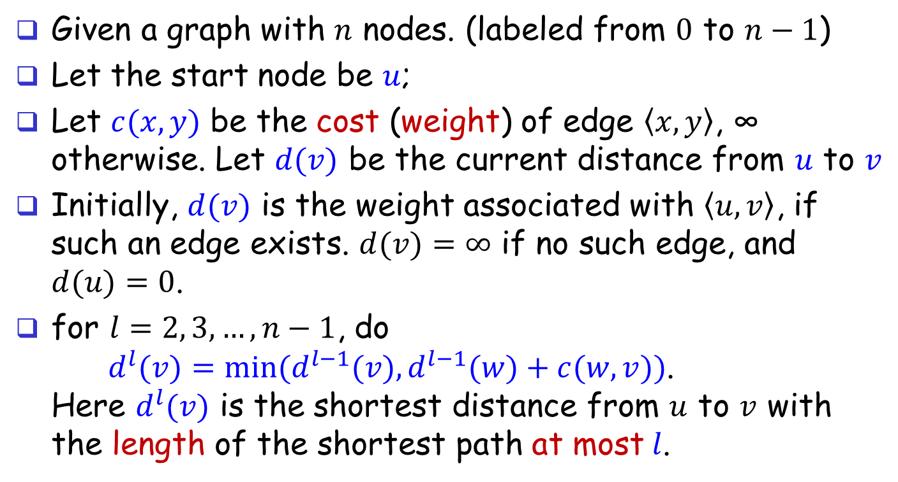
Single Source Shortest Paths: Bellman-Ford Algorithm
Given a graph with $n$ nodes. (labeled from $0$ to $n−1$)
Let the start node be $u$;
Let $c(x,y)$ be the cost (weight) of edge $\left\langle x,y\right\rangle$, ∞ otherwise. Let $d(v)$ be the current distance from $u$ to $v$
Initially, $d(v)$ is the weight associated with $\left\langle u,v\right\rangle$, if such an edge exists. $d(v)=∞$ if no such edge, and $d(u)=0$.
for $l=2, 3,…, n−1$, do $d^{l}(v)=min⁡(d^{l−1}(v), d^{l−1}(w)+c(w,v))$. Here $d^{l}(v)$ is the shortest distance from $u$ to $v$ with the length of the shortest path at most$l$.

Slide 13
Single Source Shortest Paths: Bellman-Ford Algorithm
To handle negative weights.
Time complexity: O(nm)
void BellmanFord(int n, int u) {
/* n is the number of nodes in G, and v is the start node */ int w, l; for (w = 0; w < n; w++) d(w) = c(u, w); /* initial cost from u to w */
for (l = 2; l <= n-1; l++) for (each node v such that u != v and v has at least one in-coming edge)
for (each edge <w, v> in G)
if (d(v) > d(w) + c(w, v))
d(v) = d(w) + c(w, v);
}

Slide 14
Revisit the graph with negative weights
Bellman-Ford can handle this graph
5
B
E
K
M
7
-5
1

Slide 15
All Pairs Shortest Paths
Given a weighted directed graph: nodes are cities, edges are roads and weights are the distances between two cities.
Find the shortest paths from any node to any other nodes in the graph.

Slide 16

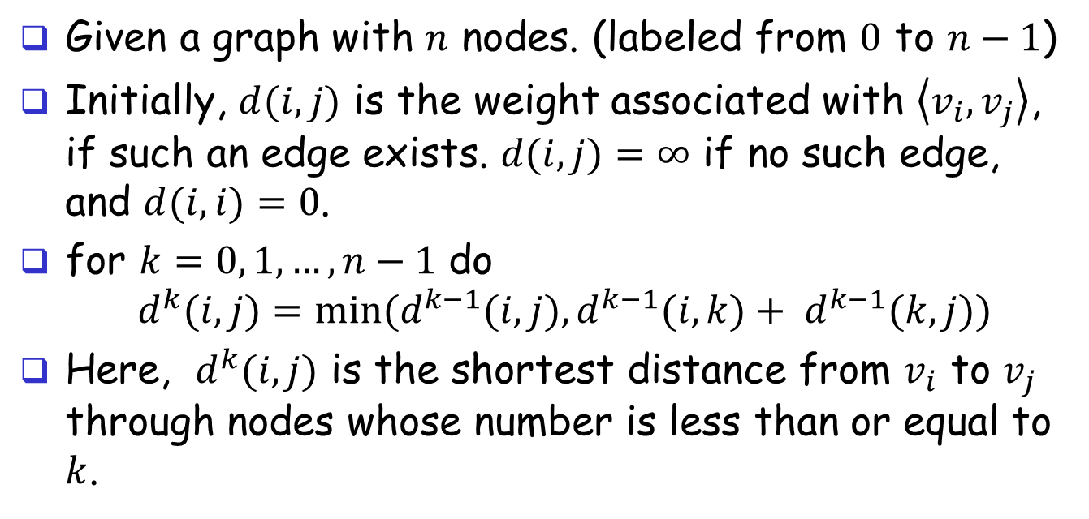
All Pairs Shortest Paths
Given a graph with $n$ nodes. (labeled from $0$ to $n−1$)
Initially, $d(i, j)$ is the weight associated with $\left\langle v_{i},v_{j}\right\rangle$, if such an edge exists. $d(i, j)=∞$ if no such edge, and $d(i, i)=0$.
for $k=0, 1,…, n−1$ do $d^{k}(i, j)=min⁡(d^{k−1}(i,j), d^{k−1}(i,k)+ d^{k−1}(k,j))$
Here, $d^{k}(i, j)$ is the shortest distance from $v_{i}$ to $v_{j}$ through nodes whose number is less than or equal to $k$.
Via nodes whose number is $≤$ k
d^{k-1}(i,j)
i
j
d^{k-1}(i,k)
d^{k-1}(k,j)
k

Slide 17
An Example
6
A
B
A
B
C
4
A
0
4
11
11
2
B
6
0
2
3
C
3
∞
0
G
C
Cost matrix for G: c[3][3]
Distance matrix d[3][3]
A⁰
A
B
C
A¹
A
B
C
A²
A
B
C
A³
A
B
C
A
0
4
11
A
0
4
11
A
0
4
6
A
0
4
6
B
6
0
2
B
6
0
2
B
6
0
2
B
5
0
2
C
3
∞
0
C
3
7
0
C
3
7
0
C
3
7
0
Initial Distance matrix
via A
via B
via C

Slide 18
The Floyd–Warshall Algorithm
void allcost(int cost[][MAX_NODES], int distance[][MAXMODES], int n) { int i, j, k; for (i = 0; i < n; i++) for (j = 0; j < n; j++)
distance[i][j] = cost[i][j];
for (k = 0; k < n; k++) for (i = 0; i < n; i++)
for (j = 0; j < n; j++)
if (distance[i][k] + distance[k][j] < distance[i][j])
distance[i][j] = distance[i][k] + distance[k][j];
}
Time complexity: O(n³)

Slide 19
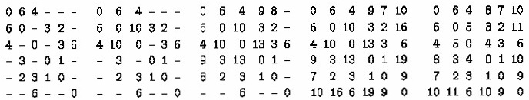
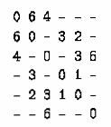
Another Example
Cost Matrix
A B C D E F
6
A
4
A
B
C
D
E
F
B
C
3
2
3
6
D
E
F
1
A B C D E F
A B C D E F
A B C D E F
A B C D E F
A B C D E F
A
B
C
D
E
F
Initial distance matrix
via A
via B
via C,D
via E,F

Slide 20
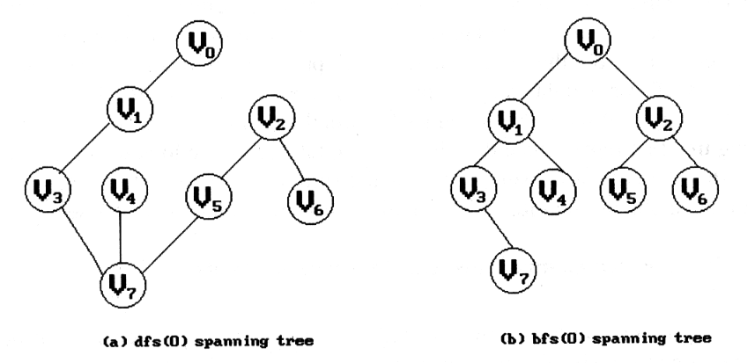

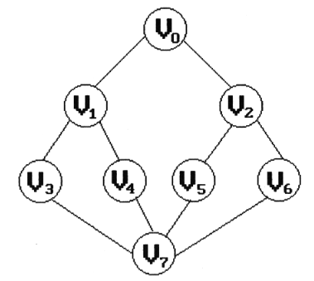
Spanning Trees
Suppose an undirected graph G = (V, E) is connected, a spanning tree T = (Vt, Et) is a cycle-free subgraph of G such that V = Vt and Et is a subset of E (Et $⊆$ E).
We want to reduce the number of edges, but maintain the connection information.
We can use either depth-first-search or breadth-first-search to get a spanning tree T for a graph G.

Slide 21
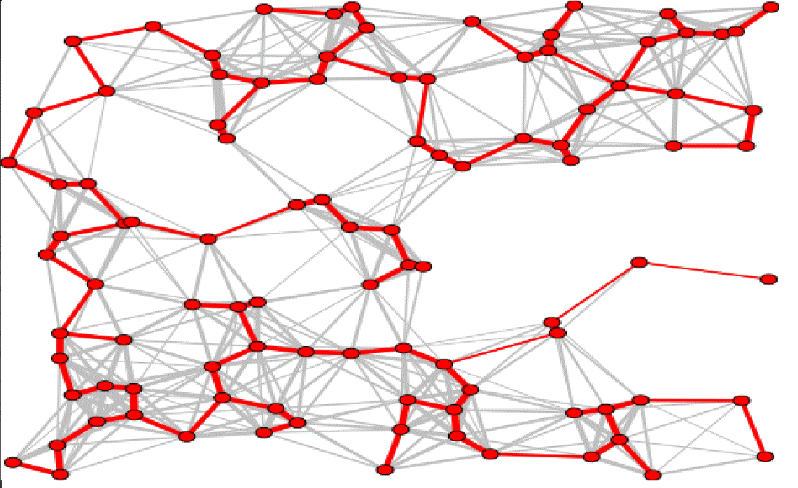
Minimum Cost Spanning Tree
Given an undirected graph G = (V, E), and assume that every edge in G is associated with a weight.
Such a graph is a weighted graph.
The cost of a spanning tree of a weighted graph is the sum of weights of its edges.
A minimum cost spanning tree is a spanning tree that has minimum cost.

Slide 22
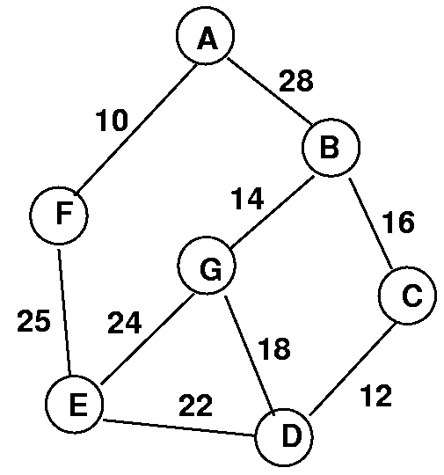
An Example of An Undirected Weighted Graph
The minimum spanning tree is the one with the smallest cost among all possible spanning trees starting from every node in a graph!
It costs too much to check all!

Slide 23
What should we do?
Do not find the minimum spanning tree after finding all possible spanning trees!
Create a tree, and add edges into the tree one by one repeatedly.
Prim’s Algorithm: Start with a 1-node and 0-edge tree and grow it into an n-node tree by repeatedly adding a node and an edge with the least cost.
Kruskal’s Algorithm: Start with an n-node 0-edge forest. Consider edges in ascending order of cost. Select an edge if it does not form a cycle together with already selected edges.
A forest is a collection of disconnected trees.

Slide 24
Prim's Algorithm
G
T
u
The algorithm (pseudo code) is outlined below.
Let T be the minimum spanning tree we want to construct for graph G, and let T be an empty tree initially;
Let TV be the set of nodes in T, and assume that it starts from a node, say node v0;
while (T is not a spanning tree yet) {
let (u, v) be a smallest weight edge in G such that
u is in TV and v is not in TV;
if (there is no such edge) break from the while loop;
add v to TV; add (u, v) to T;
}
if (T contains fewer than n-1 edges)
there is no answer because T is not even a spanning tree.
v

Slide 25
Minimum Cost Spanning Tree: Prim's Algorithm
Given an undirected weighted graph that contains n nodes.
The algorithm (pseudo code) is outlined below.
T = {};
TV = {0}; /* start with node 0 */
while (T contains fewer than n-1 edges) {
let (u, v) be a smallest weight edge in G such that
u is in TV and v is not in TV;
if (there is no such edge) break;
add v to TV; add (u, v) to T;
}
if (T contains fewer than n-1 edges)
printf("No spanning tree\n");

Slide 26
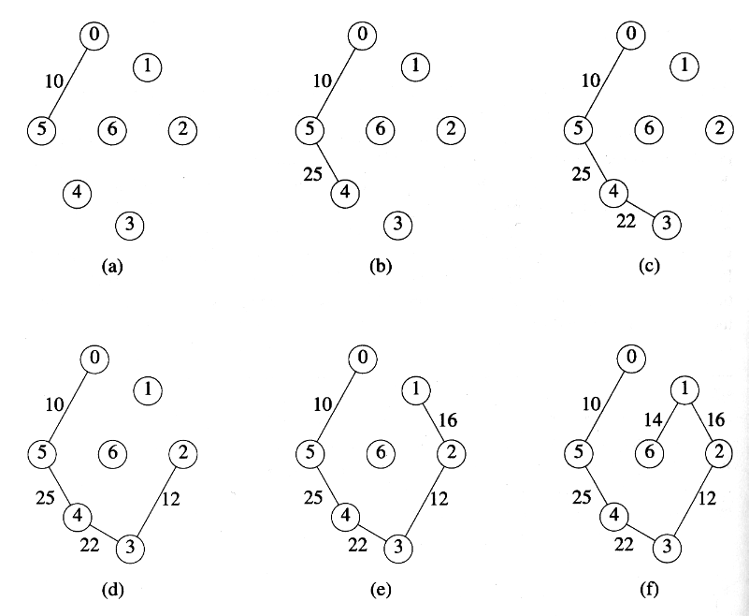
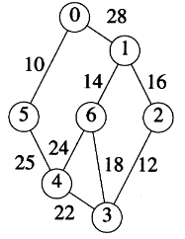
Prim’s Algorithm

Slide 27
Kruskal's Algorithm
The algorithm (pseudo codes) is outlined below.
Let T be the minimum spanning tree we want to construct for graph G, and let T be an empty tree.
while (T is not a spanning tree yet and there are still edges we can add into T from G) {
choose the edge (v,w) from G that has the smallest weight, and do not consider the edge (v, w) again;
if (the edge (v,w) does not create a cycle in T) add the edge (v,w) to T; /* if there is a cycle in T, then T is not a spanning tree */
}
if (T contains fewer than n-1 edges)
there is no answer because T is not even a spanning tree.

Slide 28
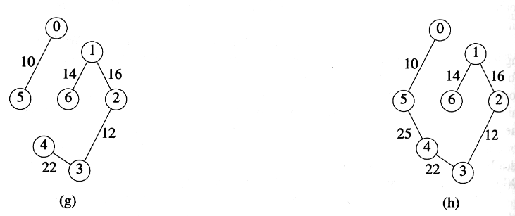
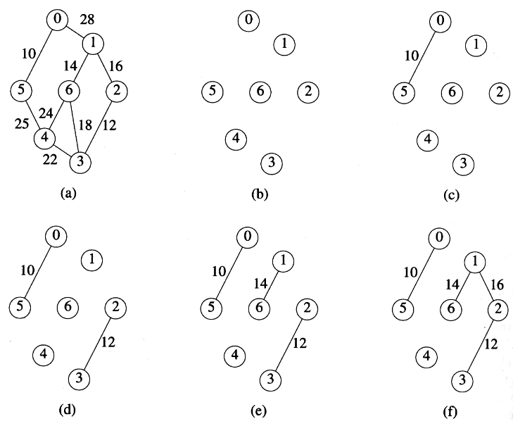
Kruskal's Algorithm

Slide 29
More About Kruskal's Algorithm
8
10
14
10
14
1
3
5
7
1
3
5
7
7
3
2
7
4
6
3
2
4
12
6
2
4
6
8
2
4
6
8
9
For edges, we need to check (1) whether E is empty, and (2) find the least-cost edge in E.
Use a min heap of edges! (Refer to max heap.)
For the tree T:
Does T have n-1 edges?
Does a new edge (u,v) added to T form a cycle?
Add (u,v) to T it if it does not form a cycle in T.

Slide 30
More About Kruskal's Algorithm
8
10
14
10
14
1
3
5
7
1
3
5
7
7
3
2
7
4
6
3
2
4
12
6
2
4
6
8
2
4
6
8
9
Does a new edge (u,v) added to T form a cycle?
Each component of T is a tree.
When u and v of an edge (u,v) in the same component, the edge (u,v) will create a cycle in T.
When u and v of (u,v) are in different components, the edge (u,v) will not create a cycle in T.

Slide 31
More About Kruskal's Algorithm
1
3
5
7
2
7
4
6
3
2
4
6
8
Each component of T is maintained by the set of nodes in it.
{1, 2, 3, 4}, {5, 6}, {7, 8}
Two nodes are in the same component iff they are in the same set of nodes.
Do not create an edge (u,v) in T if u and v are in the same set of nodes!
Cannot add edge (1, 3) into T.

Slide 32
More About Kruskal's Algorithm
1
3
5
7
2
7
4
6
3
2
4
6
8
When u and v of (u,v) are in different components, the edge (u,v) will not create a cycle in T.
Create the edge in T, and
Union the two corresponding sets into a new set. {1, 2, 3, 4} union {5, 6} → {1, 2, 3, 4, 5, 6}
Initially, there are n sets, and each set contains one node.
Refer to Disjoint Set (Section 5.10 in the textbook)

